Slide 1

Robot Obstacle avoidance with reinforcement learning
Group Members:
Alexandre Dietrich
Ankur Tyagi
Haitham Alamri
Rodolfo Vasconcelos
Intelligent Systems and Reinforcement Learning

Slide 2
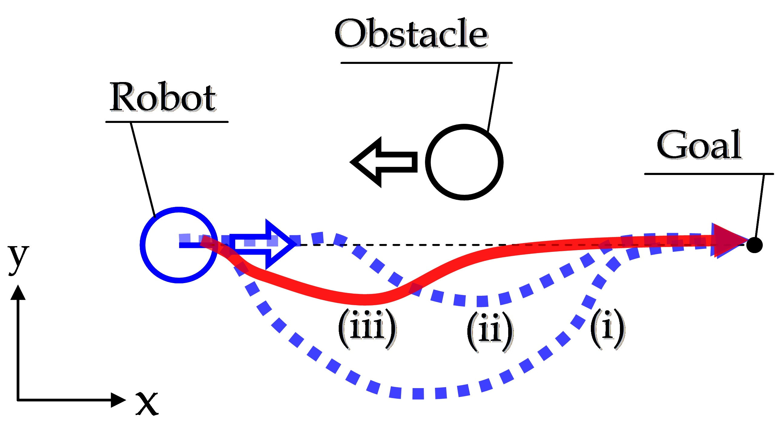
Problem Statement
Find the optimal path for robot to reach an end point (goal state) while avoiding randomly generated obstacles in a 2D space
Reference : https://bayesianadventures.wordpress.com/2015/08/31/obstacle-avoidance-for-clever-robots/

Slide 3
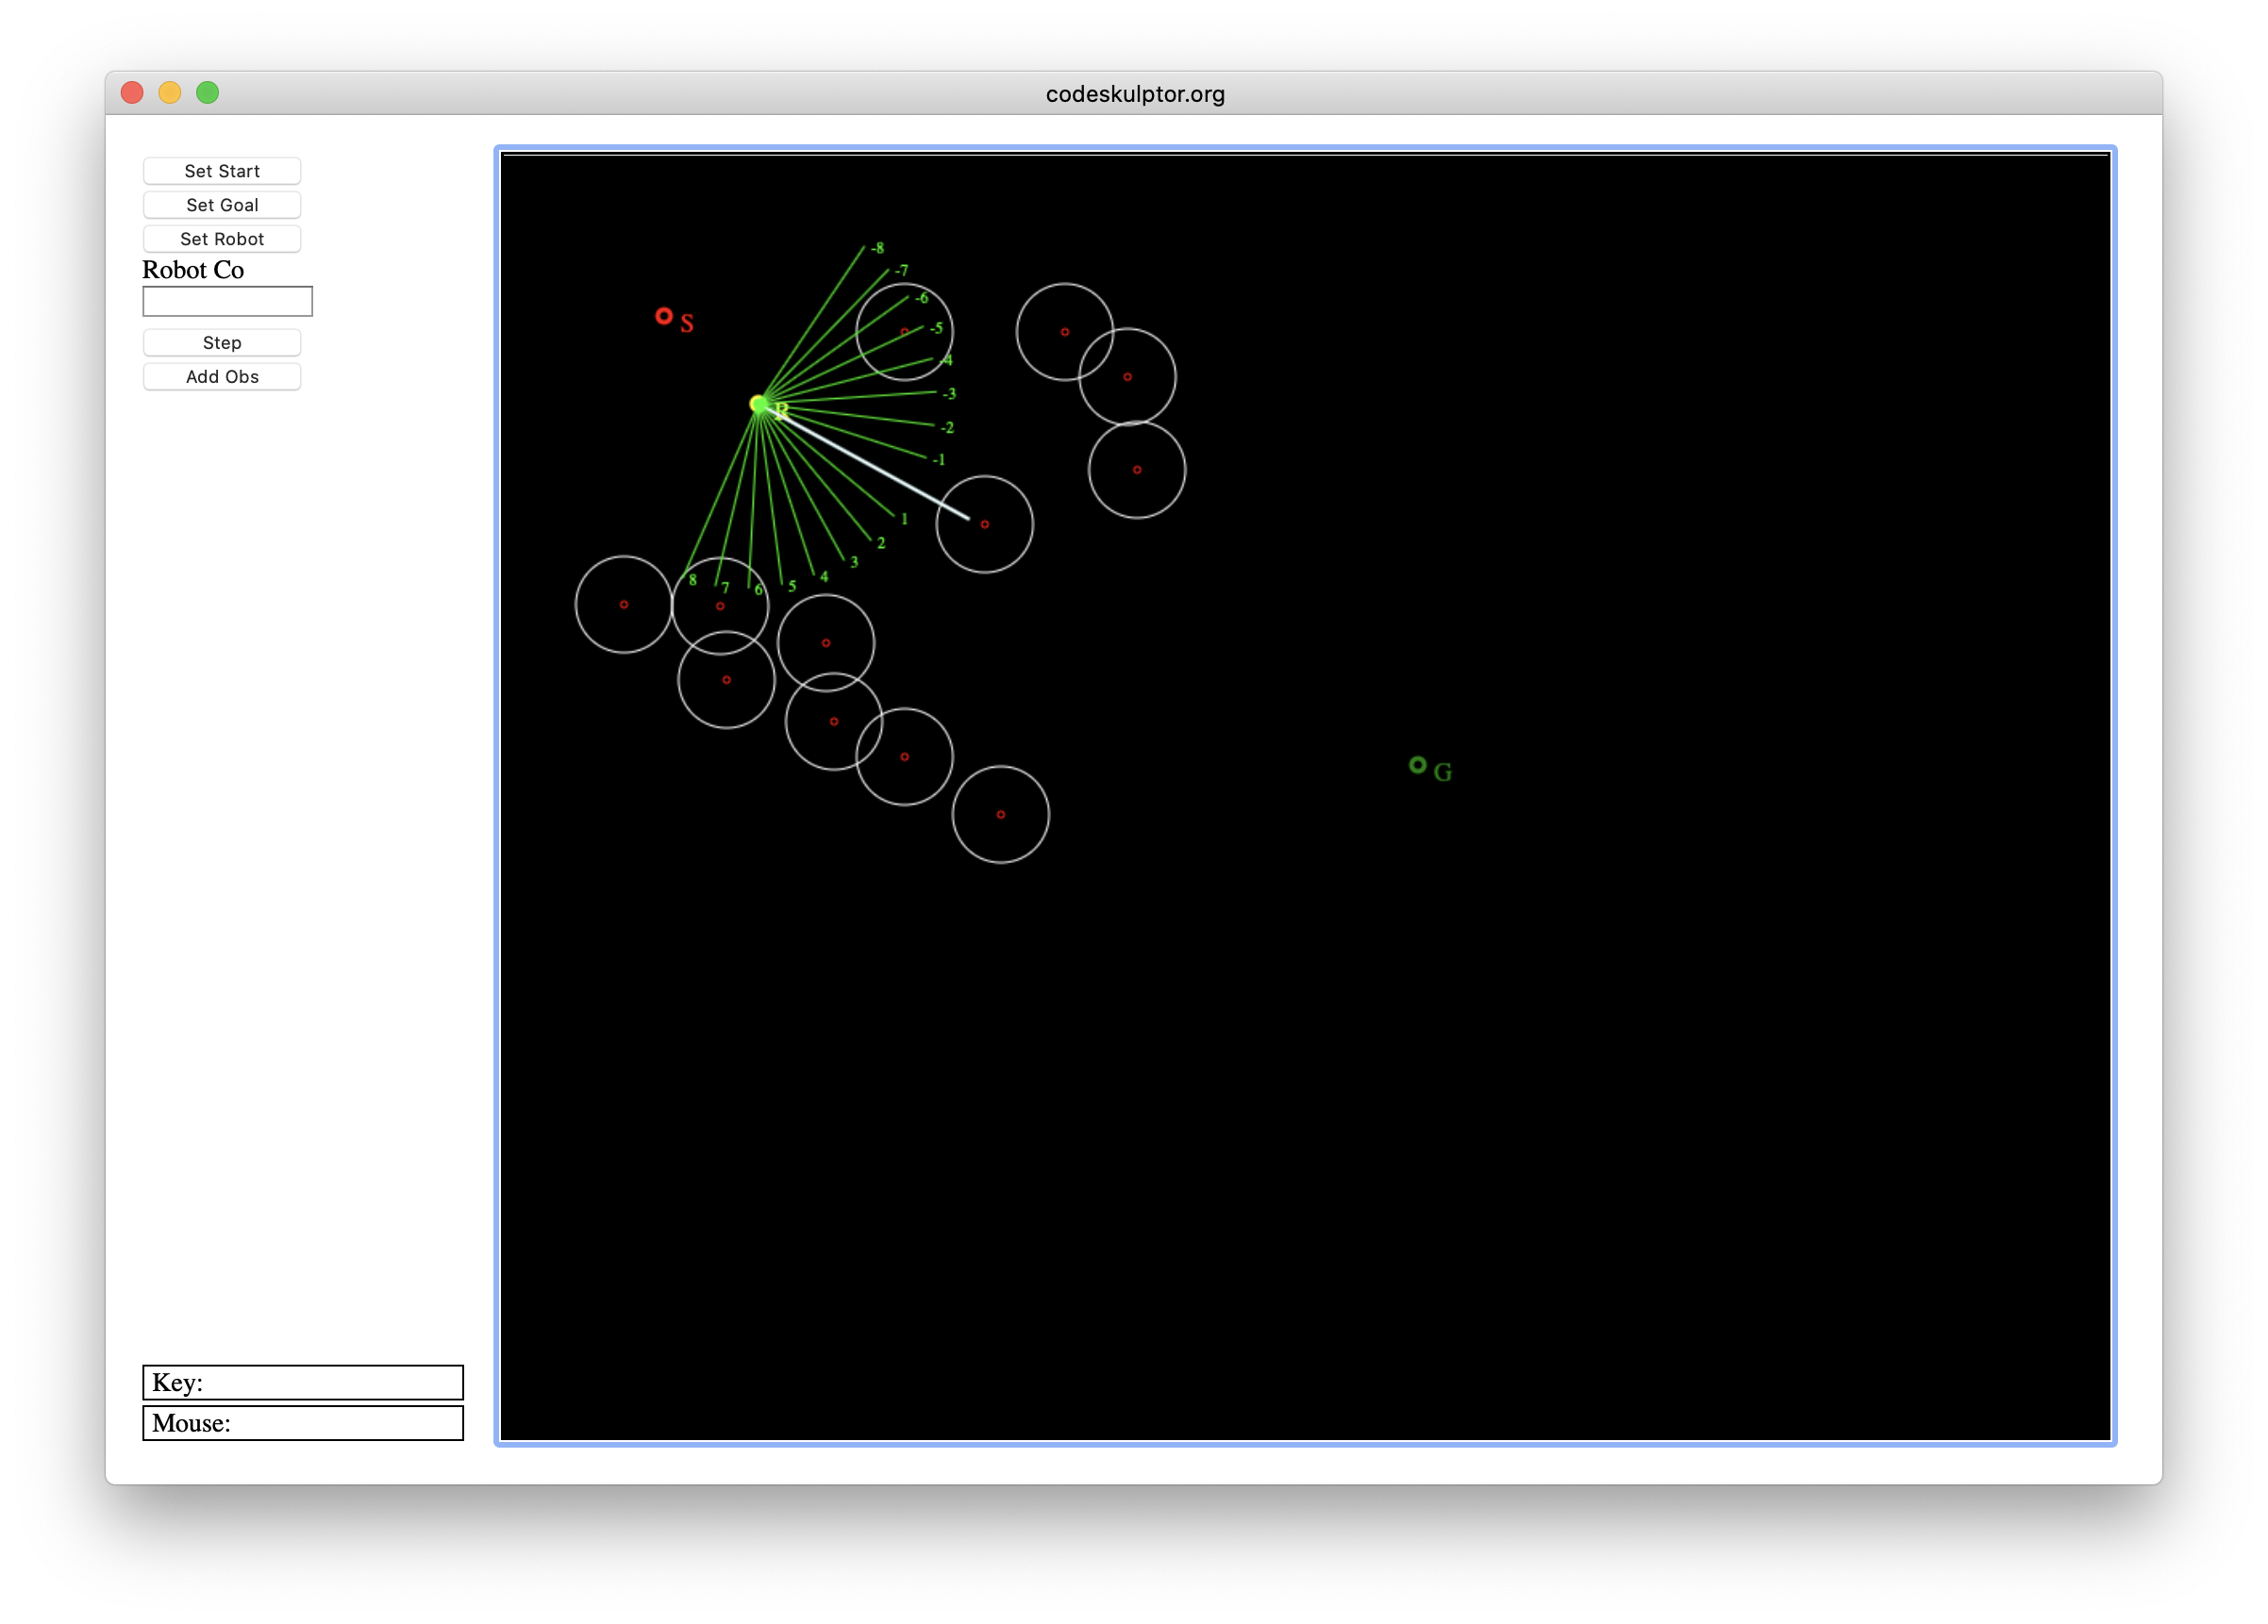
Background
Original Environment simulation created on codeskulptor
How to play :
Choose the staring point of the robot
Choose the goal
Define obstacles
Navigate the path using the step and avoid any incoming obstacles while navigating towards the target state.
Pre-requisities for setup:
Converted codeskulptor to run on python3 in local environment
Understand the Bayesian working of the module.

Slide 4
Approach - 1
Find the optimal path for robot to reach an end point (goal state) while avoiding randomly generated obstacles in a 2D space

Slide 5
Approach - 2
Find the optimal path for robot to reach an end point (goal state) while avoiding randomly generated obstacles in a 2D space

Slide 6
Conclusion
Find the optimal path for robot to reach an end point (goal state) while avoiding randomly generated obstacles in a 2D space

